Slide 1
Introduction to Cells
AP Biology

Slide 2
The Miller-Urey Experiment

Slide 3
Origins of Life
Panspermia is the hypothesis that "seeds" of life exist already all over the Universe, that life on Earth may have originated through these "seeds", and that they may deliver or have delivered life to other habitable bodies.
The RNA world hypothesis proposes that a world filled with life based on ribonucleic acid (RNA) predates the current world of life based on deoxyribonucleic acid (DNA). RNA, which can both store information like DNA and act as an enzyme, may have supported cellular or pre-cellular life. Some hypotheses as to the origin of life present RNA-based catalysis and information storage as the first step in the evolution of cellular life.

Slide 4
All organisms share fundamental properties
Cellular organization- all organisms consist of one or more cells-complex, organized assemblages of molecules enclosed within membranes
Sensitivity- all organisms respond to stimuli-though not always to the same stimuli in the same ways
Growth- All living things assimilate energy and use it to maintain order and grow, a process called metabolism.
Development- Both unicellular and multicellular organisms organisms undergo systematic, gene-directed changes as they grow and mature.
Reproduction- Organisms reproduce, passing on genes from one generation to the next.
Regulation- All organisms have regulatory mechanisms that coordinate internal processes.
Homeostasis- All living things maintain relatively constant internal conditions, different from their environment.
Heredity- All organisms on Earth posses a genetic system that is based on the replication of a long, complex molecule called DNA. This mechanism allows for adaptation and evolution over time and is a distinguishing characteristic of living organisms.

Slide 5
Compartmentalization

Slide 6
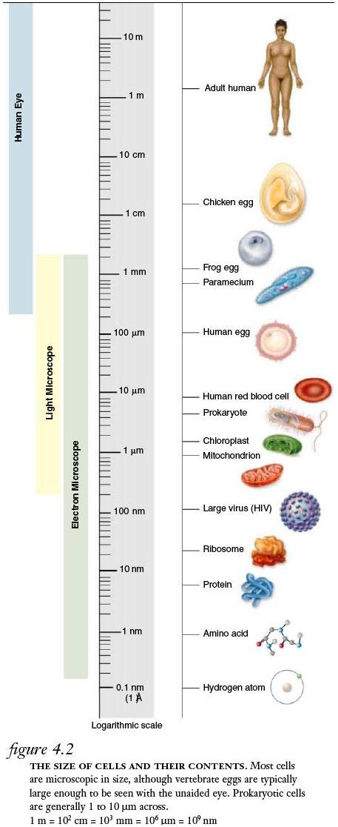
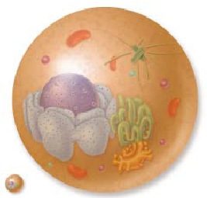
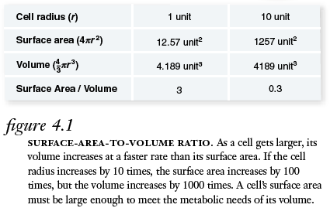

Slide 7
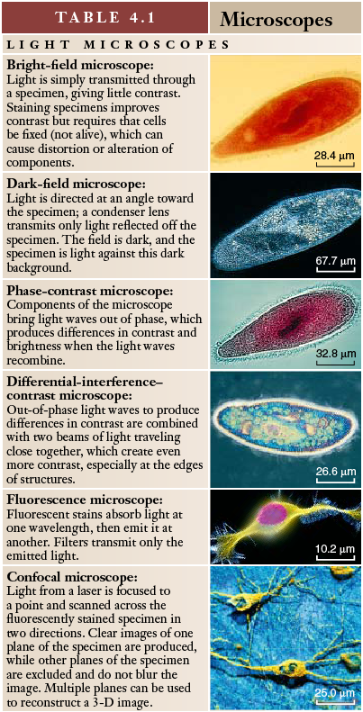
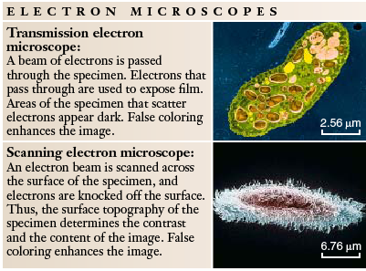

Slide 8
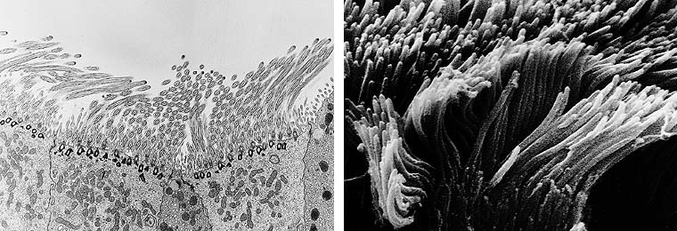
Figure 6.4 Electron micrographs
Transmission Electron Microscopy Scanning Electron Microscopy

Slide 9
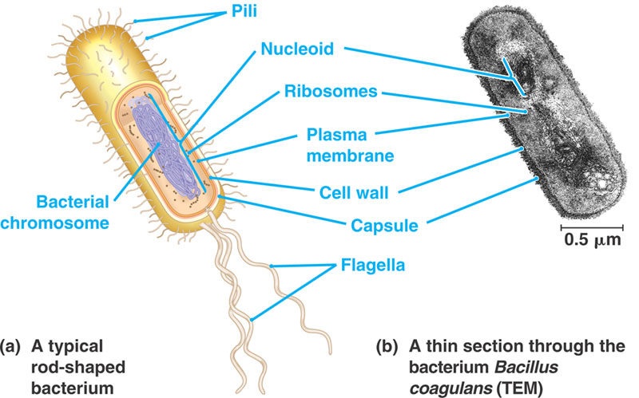
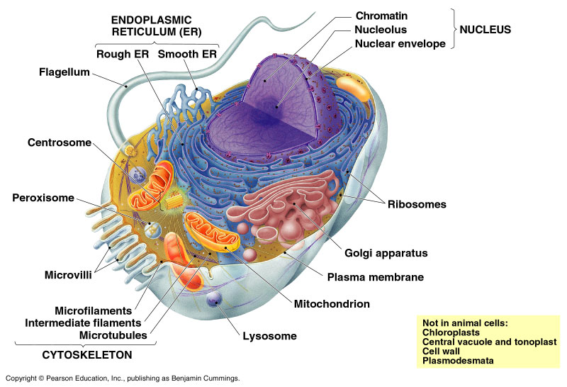
Prokaryotes vs. Eukaryotes
Prokaryotes
Bacteria and cyanobacteria
1-10μm
Few or no organelles
Circular DNA
No cytoskeleton or cytoplasmic streaming
Chromosomes segregate by attachments to plasma membrane
Mainly unicellular
Eukaryotes
Protists, fungi, plants and animals
5-100μm
Organelles
Long linear DNA
Cytoskeleton and cytoplasmic streaming
Chromosomes segregate by cytoskeletal spindle apparatus
Often multicellular

Slide 10
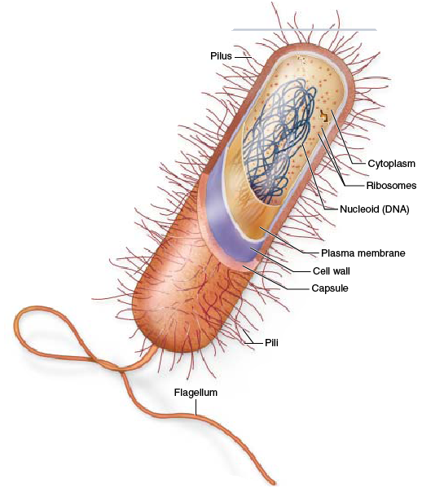
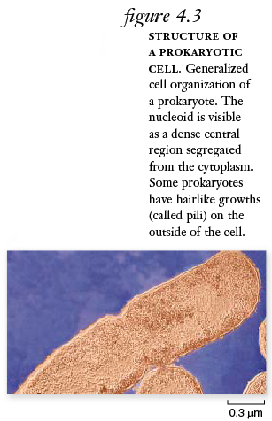

Slide 11
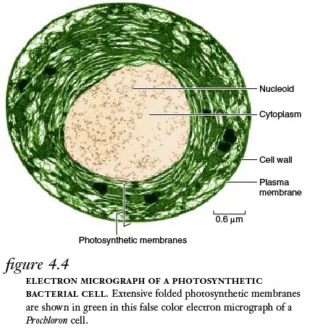

Slide 12
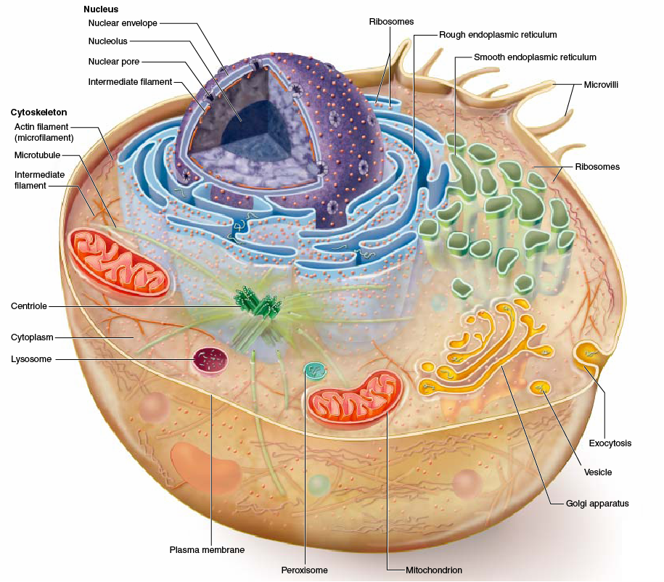

Slide 13
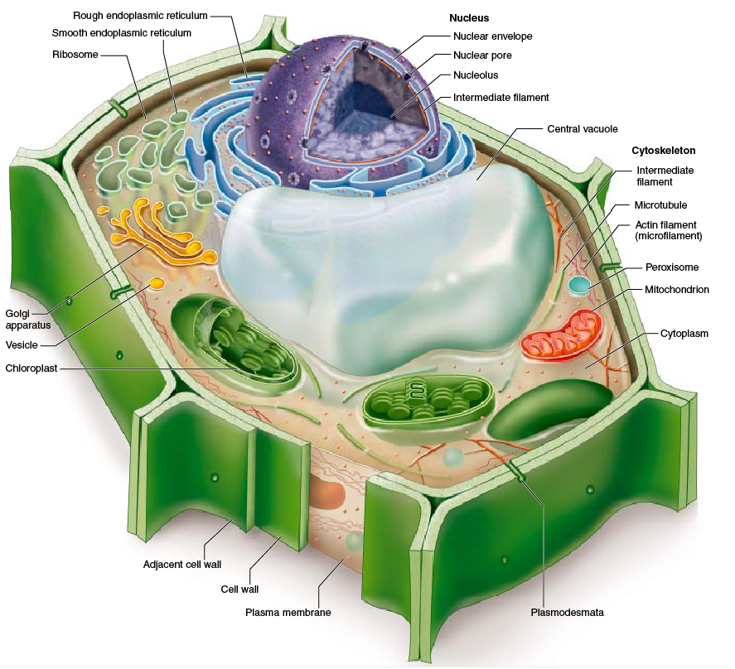

Slide 14
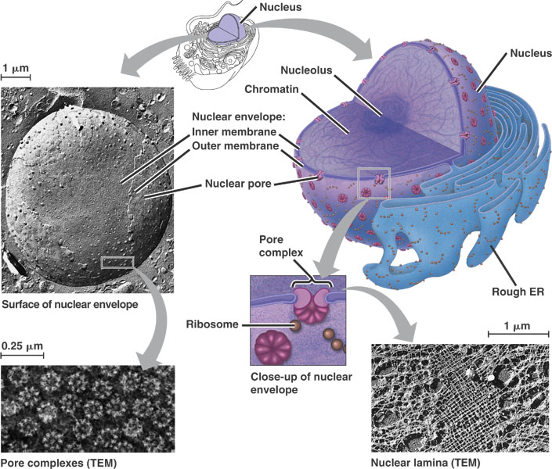
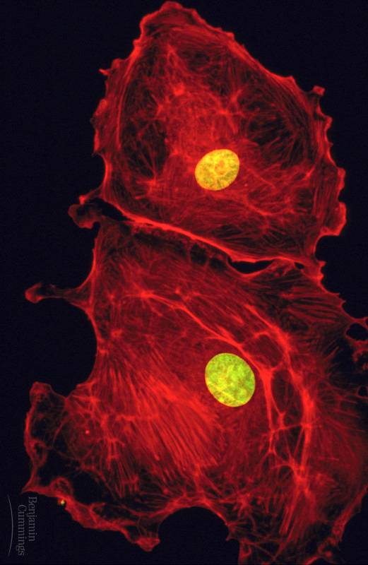
The nucleus and its envelope
Nuclei and actin

Slide 15
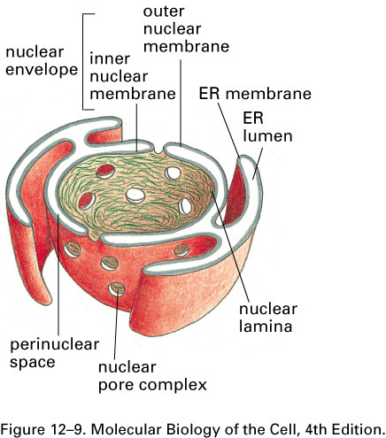
The Nucleus

Slide 16
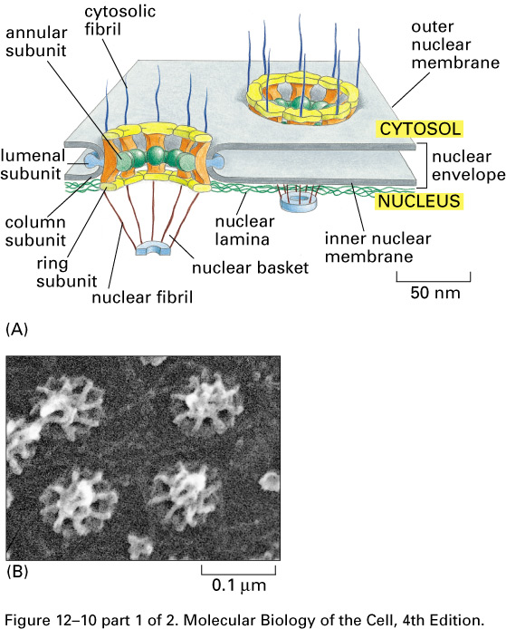
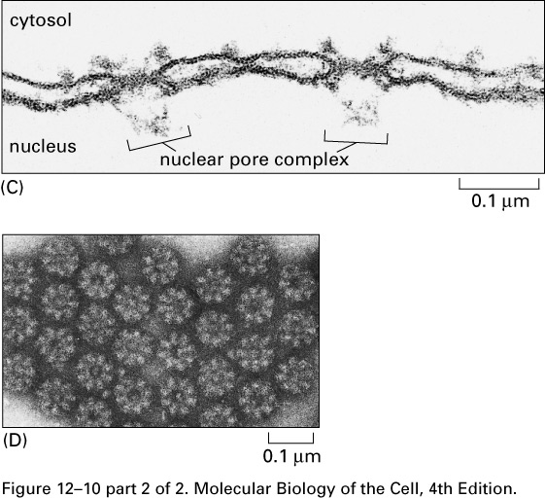
Nuclear Pore Complex

Slide 17
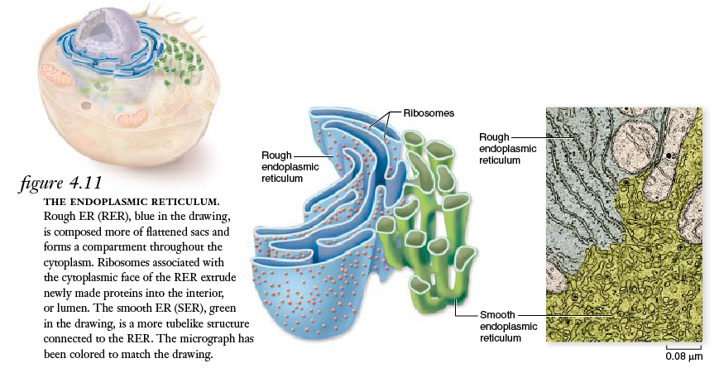
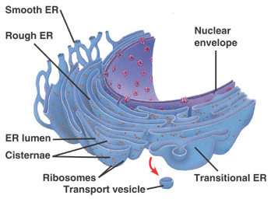
The Smooth and Rough ER (sER and rER)

Slide 18
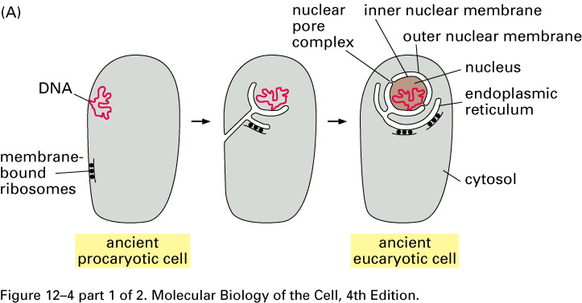
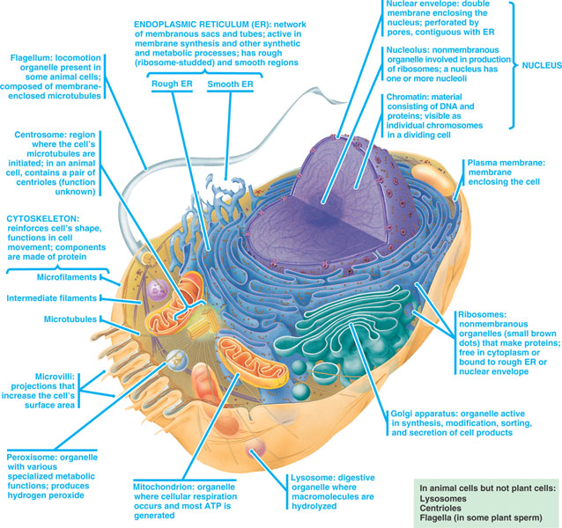
Origin of Nucleus and Endoplasmic Reticulum

Slide 19
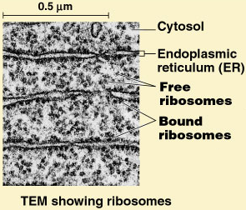
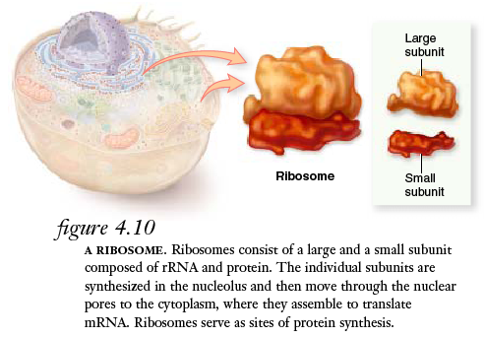
Ribosomes

Slide 20
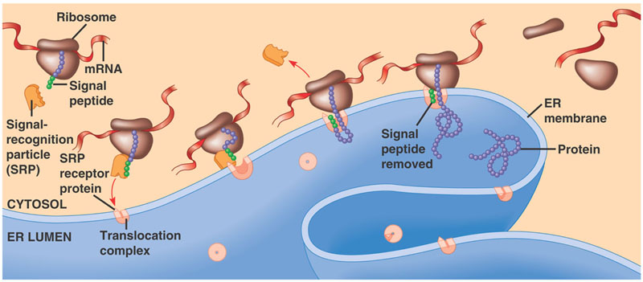
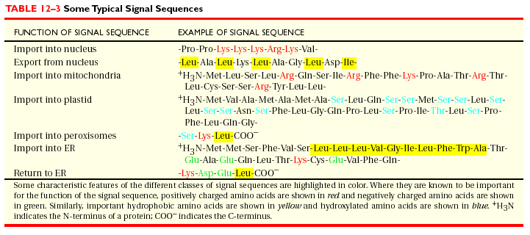
The signal mechanism for targeting proteins to the ER
All translation starts in the cytoplasm
Signal sequence directs destination

Slide 21
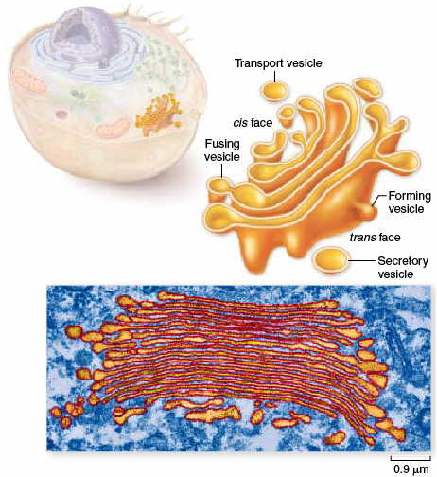
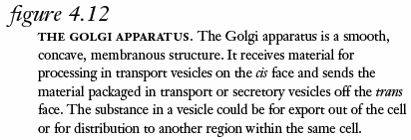
The Golgi Apparatus

Slide 22
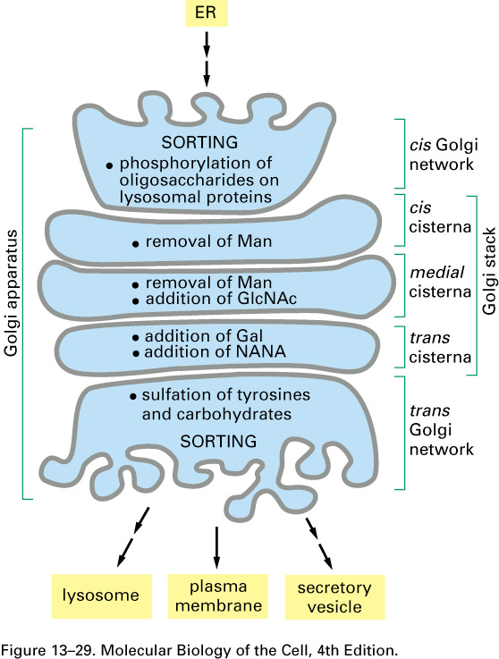
Modification of Proteins by the Golgi Apparatus

Slide 23
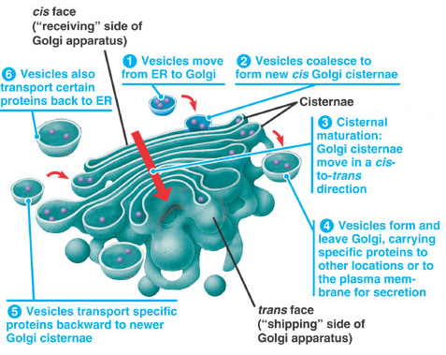
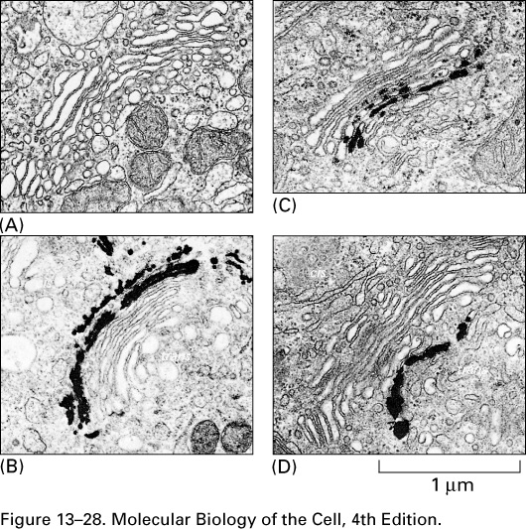
Movement through the Golgi
http://www.youtube.com/watch?v=rvfvRgk0MfA
Notes:
Not so fast-evidence for cisternal maturation is not as clear as this text makes out.

Slide 24
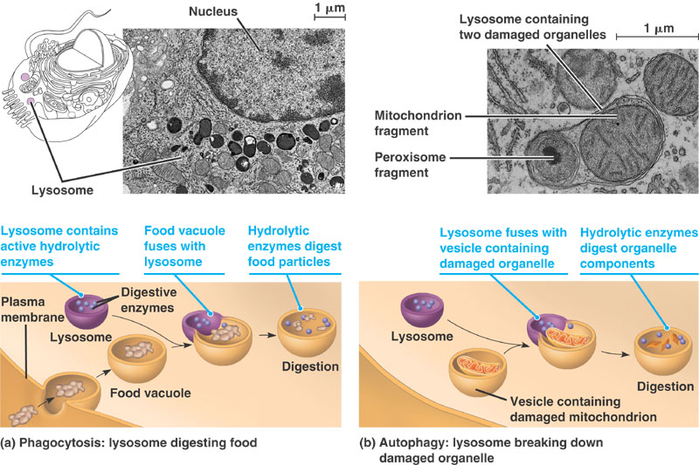
Lysosomes

Slide 25
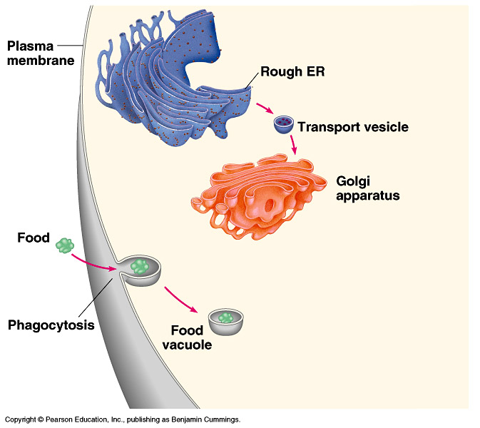
The formation and functions of lysosomes (Layer 1)

Slide 26
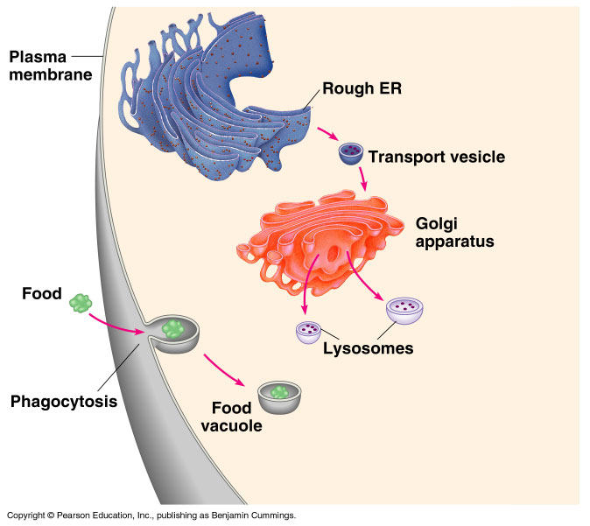
The formation and functions of lysosomes (Layer 2)

Slide 27
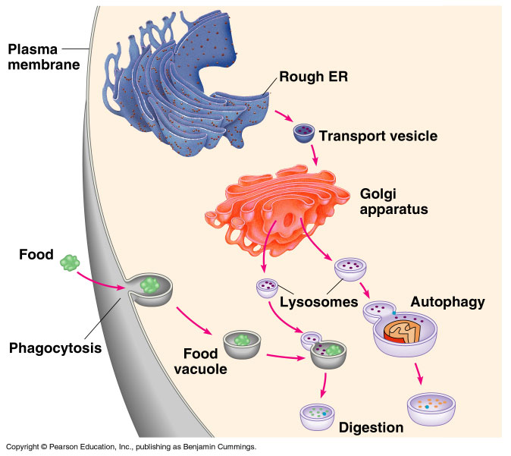
The formation and functions of lysosomes (Layer 3)

Slide 28
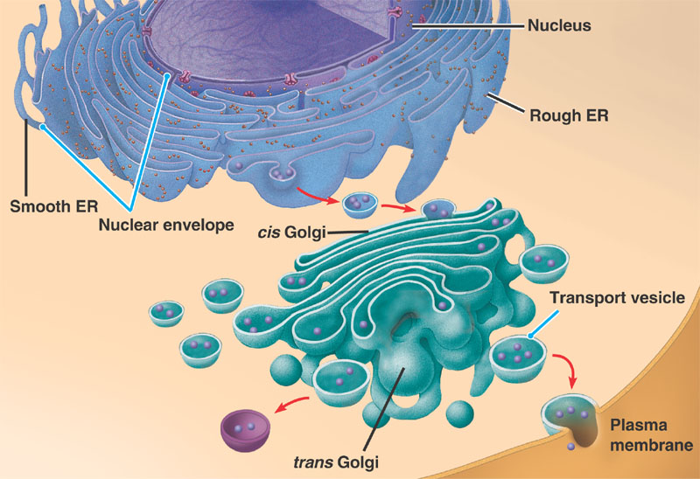
Review: relationships among organelles of the endomembrane system

Slide 29
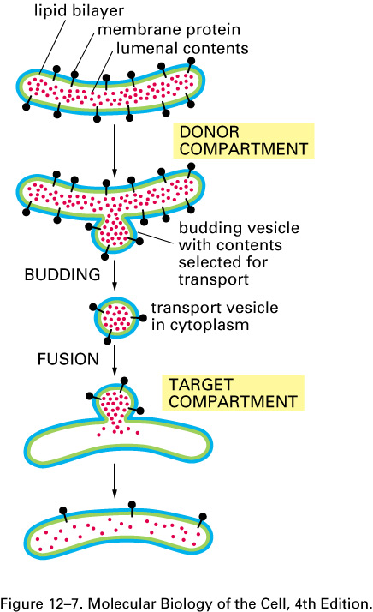
Vesicle budding and fusion during vesicular transport
Membrane orientation applies both to the lipid bilayer and transmembrane proteins

Slide 30
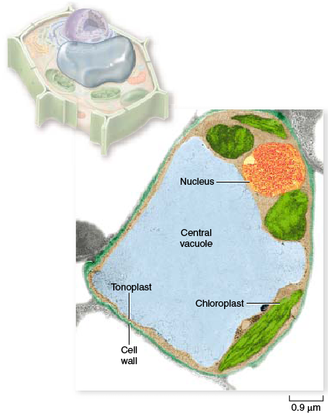
The plant cell vacuole

Slide 31
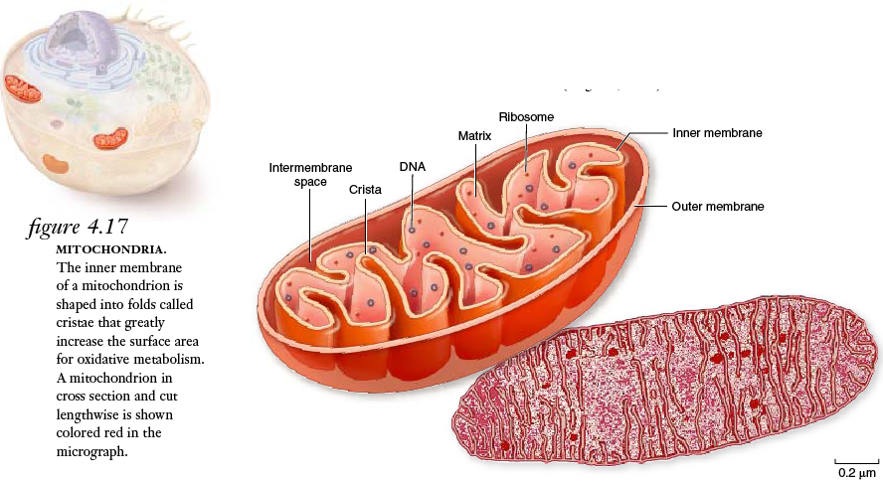
The mitochondrion, site of cellular respiration

Slide 32
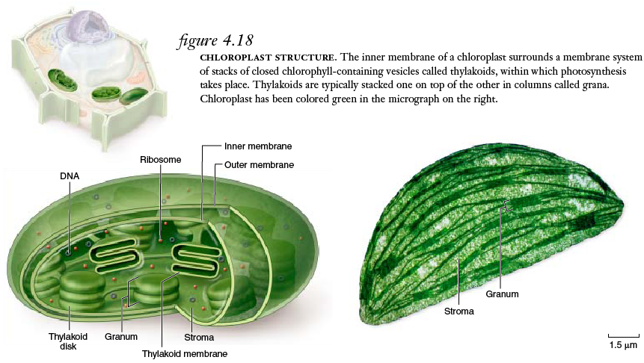
The chloroplast, site of photosynthesis

Slide 33
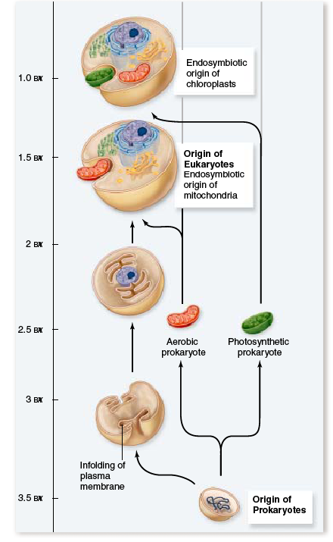
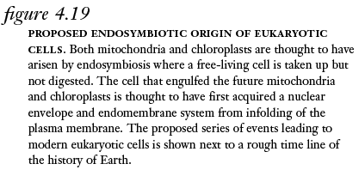
Origin of Mitochondria

Slide 34
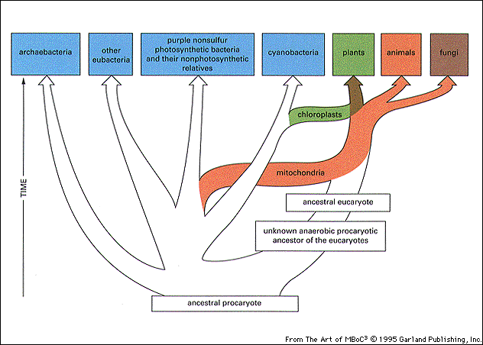
You are here
You were here

Slide 35
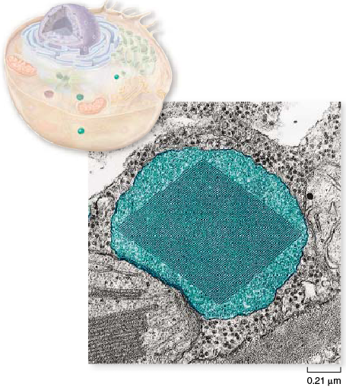
Peroxisomes

Slide 36
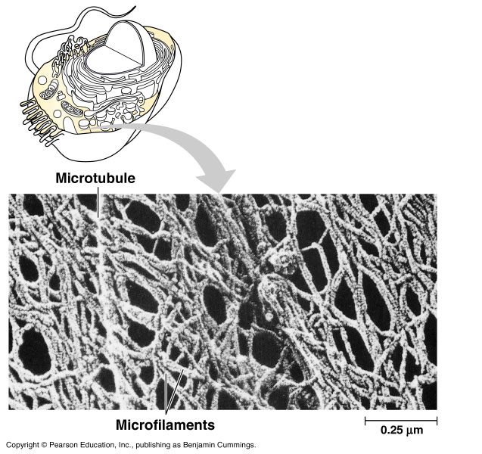
The cytoskeleton

Slide 37
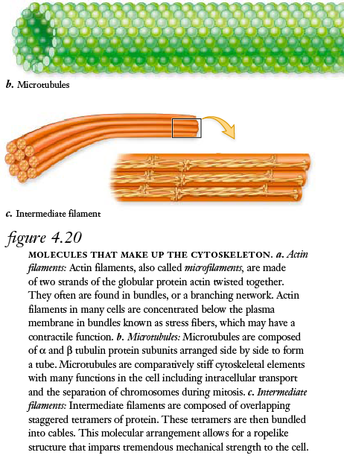
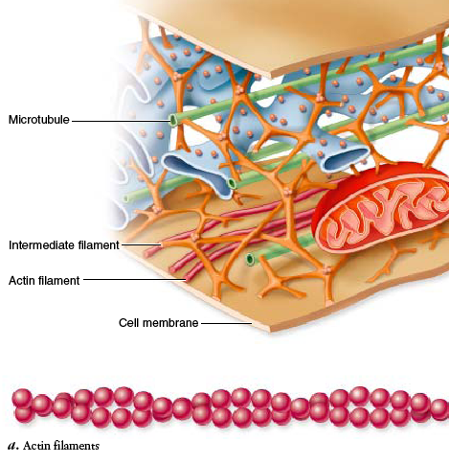
Cytoskeletal elements

Slide 38
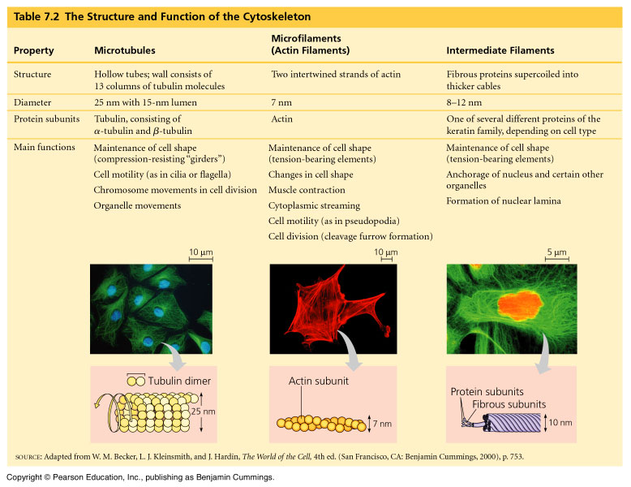
The structure and function of the cytoskeleton

Slide 39
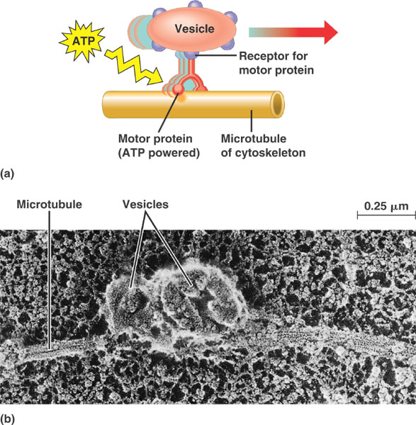
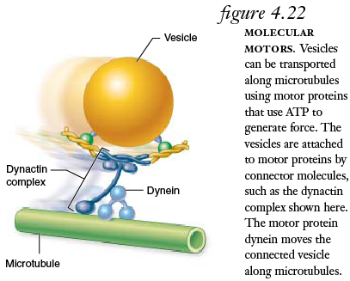
Motor proteins and the cytoskeleton
Notes:
SEM giant squid axon-neurotransmitter

Slide 40
Centrosome containing a pair of centrioles
Microtubules

Slide 41
Movement of Cells

Slide 42
A comparison of the beating of flagella and cilia
Microtubules

Slide 43
Ultrastructure of a eukaryotic flagellum or cilium
Microtubules

Slide 44
How dynein “walking” moves cilia and flagella

Slide 45
A structural role of microfilaments
Actin

Slide 46
Microfilaments and motility

Slide 47
Actin

Slide 48
Plant cell walls
Cell surfaces and junctions

Slide 49
Intercellular junctions in animal tissues
Cell surfaces and junctions

Slide 50
Extracellular matrix (ECM) of an animal cell

