Slide 1
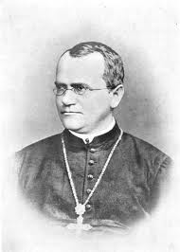
Patterns of Inheritance

Slide 2
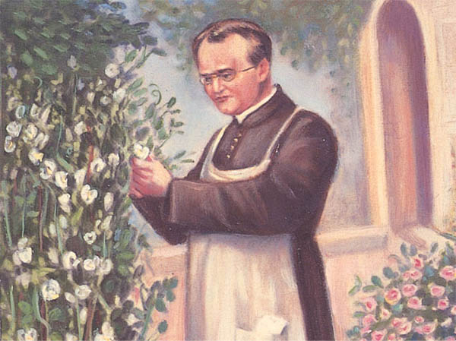
About Mendel
Mendel grew up on his parents′ small farm in a region of Austria that is now part of the Czech Republic.
In 1843, at the age of 21, Mendel entered an Augustinian monastery.
Around 1857, Mendel began breeding garden peas in the abbey garden in order to study inheritance.

Slide 3
Why Peas?
They are available in many characters.
A character is a heritable feature, such as flower color, that varies among individuals.
Each variant for a character, such as purple or white color for flowers, is called a trait.
One variety has purple flowers, while another variety has white flowers.
Mendel could also strictly control which plants mated with which

Slide 4
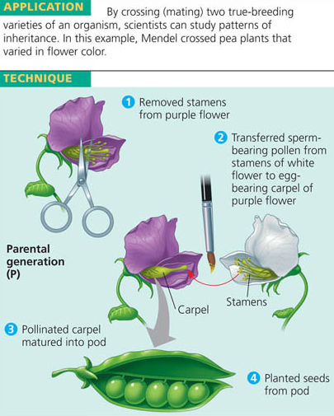

Slide 5
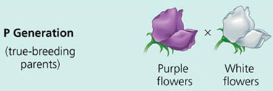
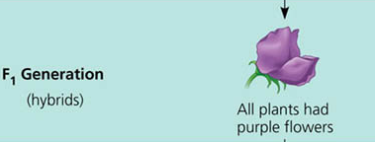
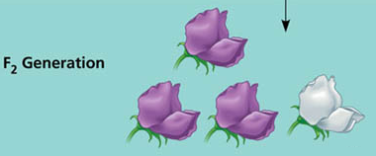
Mendels Experiment

Slide 6
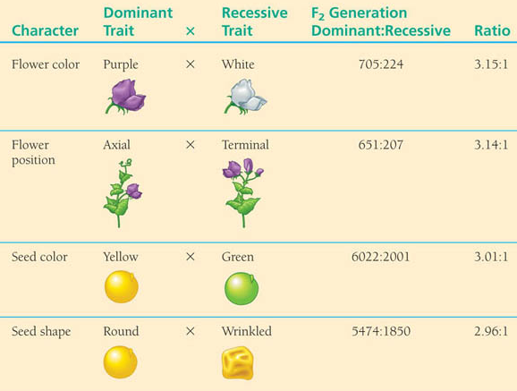
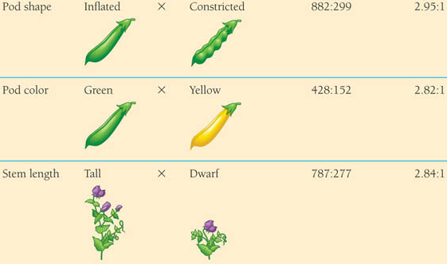
Menels Results

Slide 7
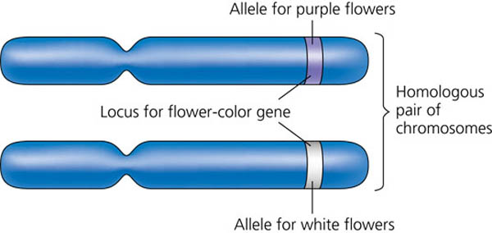
Mendel’s Four Conclusions
First, alternative versions of genes account for variations in inherited characters. (maternal and paternal)
Two different traits for every character (now known to be controlled by alleles, different variations of a gene)

Slide 8
Mendel’s Four Conclusions (con’t)
Second, for each character, an organism inherits two alleles, one from each parent.
Third, if the two alleles at a locus differ, then one, the dominant allele, determines the organism′s appearance; the other, the recessive allele, has no noticeable effect on the organism′s appearance.

Slide 9
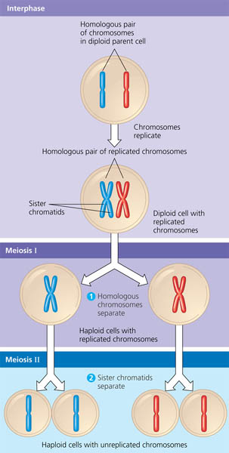
Mendel’s Four Conclusions (con’t)
The fourth part of Mendel′s model is the Law of Segregation
States that the two alleles for a heritable character separate (segregate) during gamete formation and end up in different gametes.

Slide 10
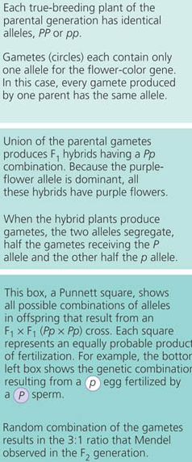
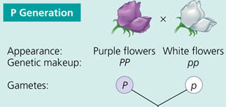
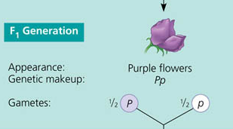
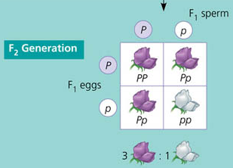
Do Mendels explanations make sense?

Slide 11
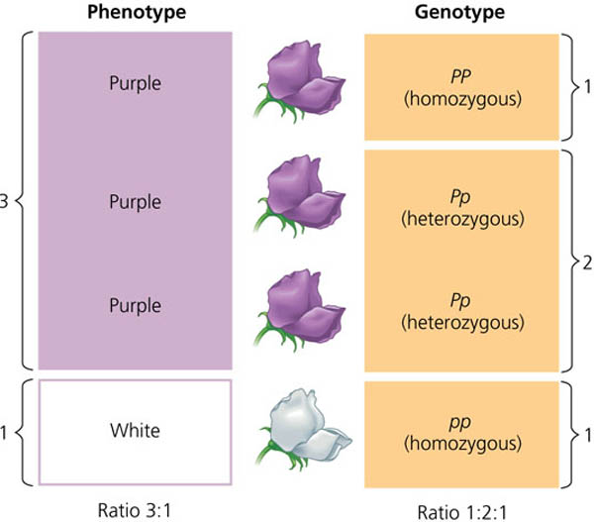
Modern Genetics-Vocabulary

Slide 12
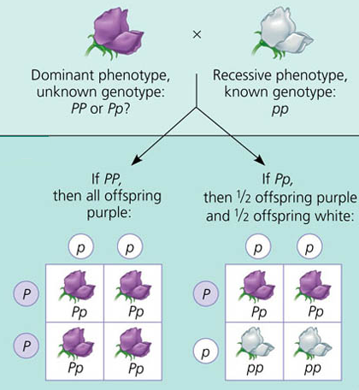
Modern Genetics-Test Cross

Slide 13
Law of Independent Assortment (Mendels second law)
Each pair of alleles segregates independently of other pairs of alleles during gamete formation
Mendel identified his second law of inheritance by following two characters at the same time.
For instance, two of the seven characters Mendel studied were seed color and seed shape.
Seeds may be either yellow or green. They also may be either round (smooth) or wrinkled.

Slide 14
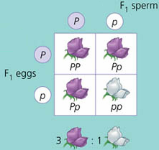
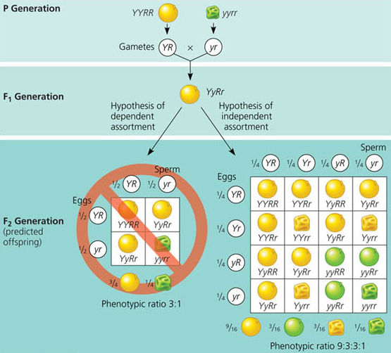
Monohybrid/Dihybrid Crosses
Monohybrid
Dihybrid

Slide 15
Limitations
Applies each pair of alleles segregates independently of other pairs of alleles during gamete formation
In other words, alleles that are on chromosomes that are not homologous.
Genes located near each other on the same chromosome tend to be inherited together and have more complex inheritance patterns than predicted by the law of independent assortment.

Slide 16
Mendelian Genetics vs. Modern Genetics
Mendelian Genetics allelic relationships
Complete dominance- The situation in which the phenotypes of the heterozygote and dominant homozygote are indistinguishable.
Modern Genetics allelic relationships
Codominance
Incomplete Dominance
Pleiotropy
Epistasis
Polygenic Inheritance
Complementation

Slide 17
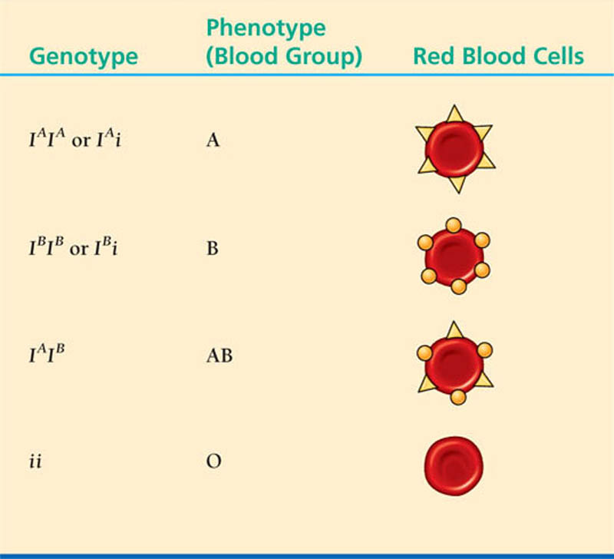
Codominance
Codominance- The situation in which the phenotypes of both alleles are exhibited in the heterozygote.

Slide 18
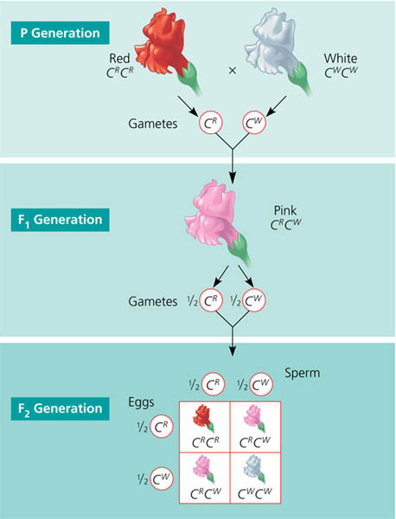
Incomplete Dominance
Incomplete dominance- The situation in which the phenotype of heterozygotes is intermediate between the phenotypes of individuals homozygous for either allele.

Slide 19
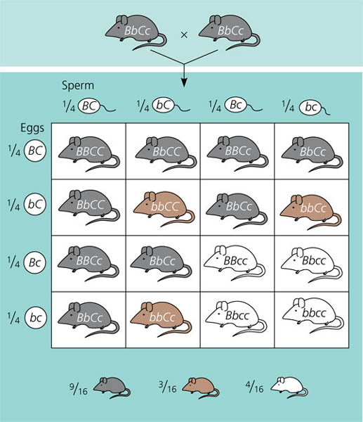
Epistasis
Epistasis- A type of gene interaction in which one gene alters the phenotypic effects of another gene that is independently inherited (at two different loci).
This is how hair color in mammals operates.
B-production of pigments
(B-black, b-brown)
C-deposition of pigments
(C-deposition, c-no deposition)

Slide 20
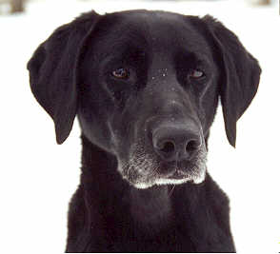
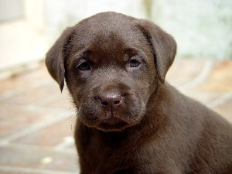
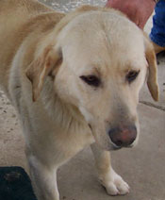
Epistasis
Explains hair and skin color in mammals
B- black E- deposition of pigment
b- brown e- pigment not deposited
Developmentally downstream
e is the epistatic allele
BBEE, BbEE, BBEe, BbEe
bbEE or bbEe
bbee

Slide 21
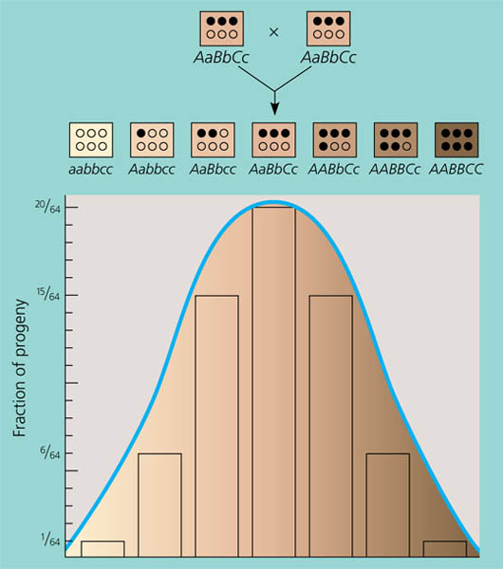
Polygenic Inheritance
Polygenic Inheritance- An additive effect of two or more gene loci on a single phenotypic character.
Quantitative character-A heritable feature that varies continuously over a range rather than in an either–or fashion.
Variable penetrance
Variable expressivity
Both are influenced by environment

Slide 22
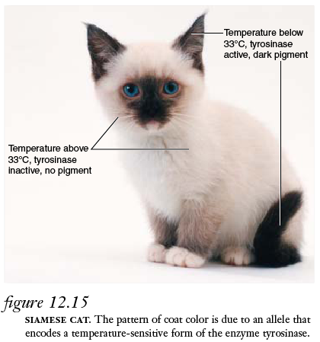
Nature vs. Nurture
A single tree, locked into its inherited genotype, has leaves that vary in size, shape, and greenness, depending on exposure to wind and sun.
For humans, nutrition influences height, exercise alters build, sun–tanning darkens the skin, and experience improves performance on intelligence tests.
Even identical twins, who are genetic equals, accumulate phenotypic differences as a result of their unique experiences.

Slide 23
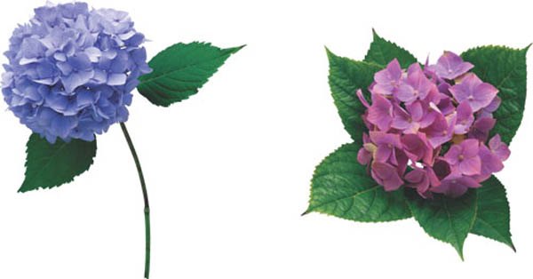
Environmental Factors
Norm of Reaction- The range of phenotypes produced by a single genotype, due to environmental influences.
Multifactorial- Referring to a phenotypic character that is influenced by multiple genes and environmental factors.
Hydrangea flowers of the same genetic variety range in color from blue–violet to pink, depending on the acidity of the soil.

Slide 24
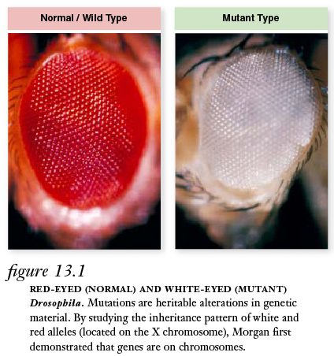
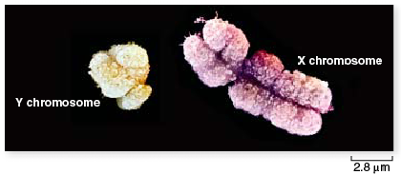
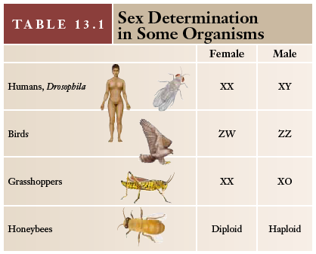
Sex and sex-linkage

Slide 25
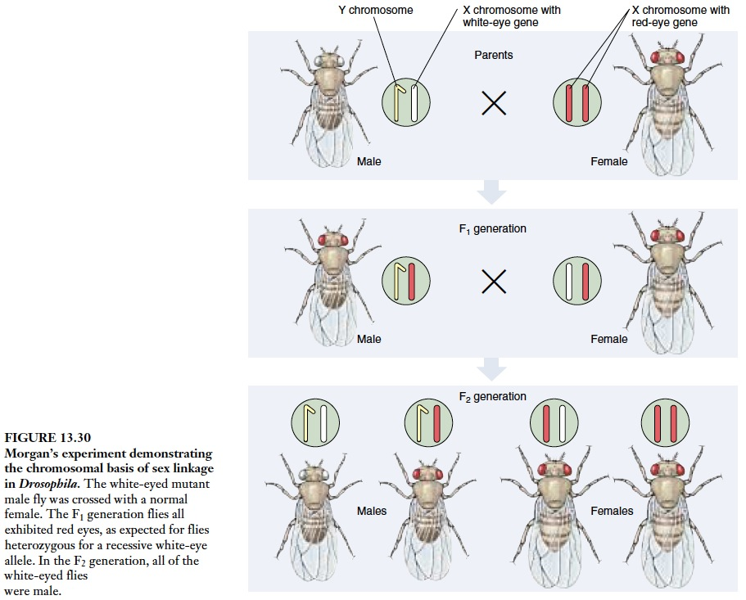

Slide 26
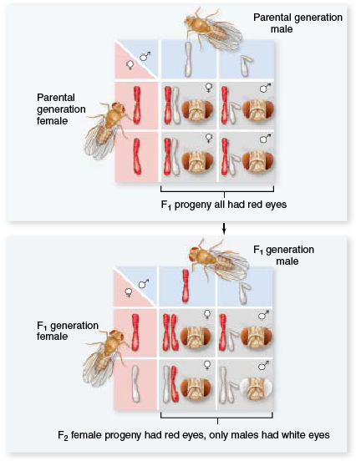
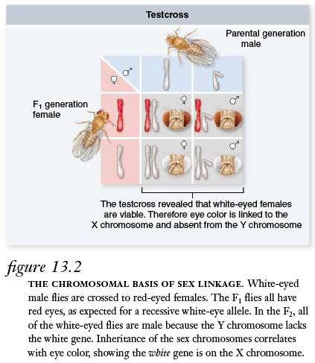
Sex-linked genes

Slide 27
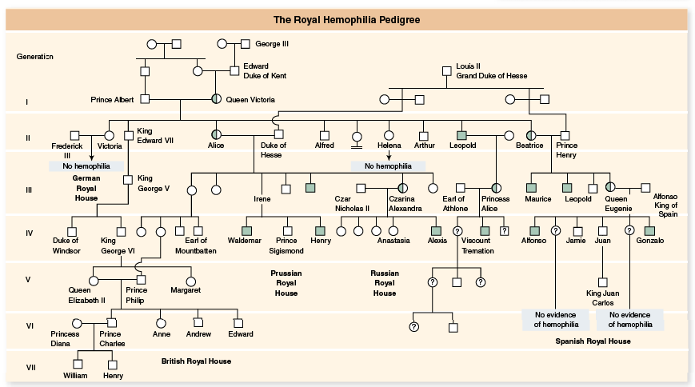
Analyzing Human Inheritance Patterns

Slide 28
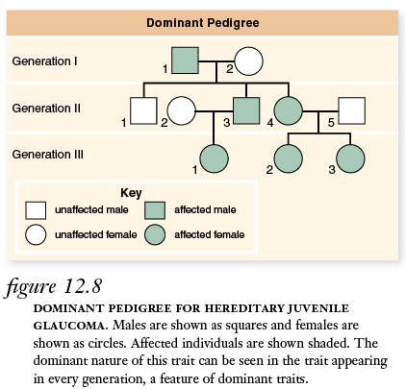
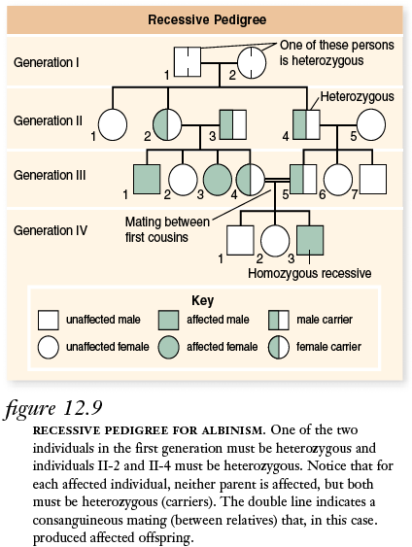

Slide 29
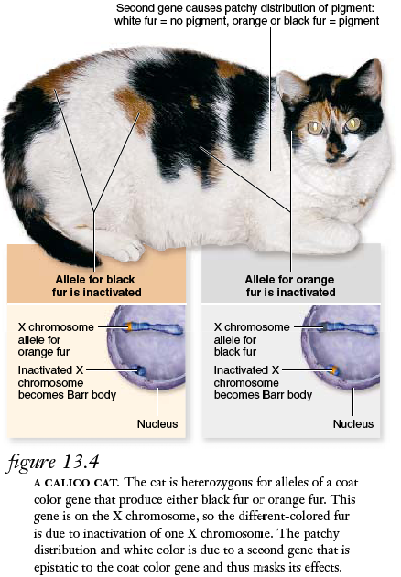
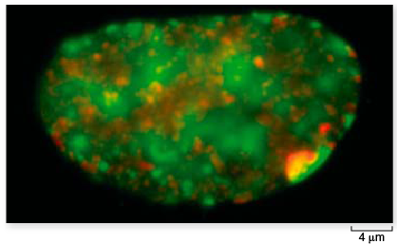
Barr Bodies
The condensed, single X-chromosome, appearing as a densely staining mass, that is found in the nuclei of somatic cells of female mammals.

