Slide 1
Evolution and Genes

Slide 2
Introduction to Evolution
Evolution is descent with modification
Darwins ideas were first published in his book On the Origin of Species
-Used the phrase “descent with modification”

Slide 3
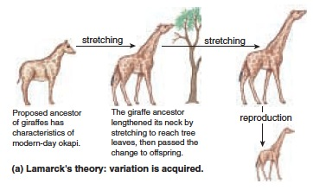
Darwin was not the first
Jean-Baptiste Lemark first proposed a mechanism before Darwin
He proposed that evolution occurred by the inheritance of acquired characteristics

Slide 4
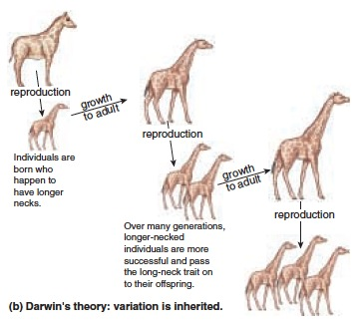
Darwin’s mechanism
Darwin proposed natural selection
Natural selection produces evolutionary change when in a population some individuals, which possess certain inherited characteristics, produce more surviving offspring than individuals lacking these characteristics.

Slide 5
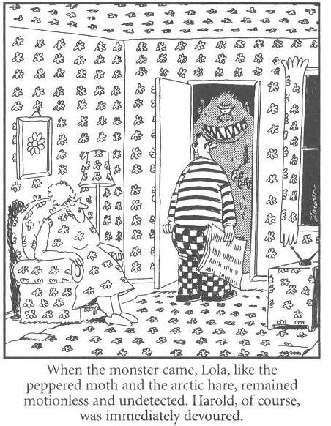
Natural Selection
For natural selection to happen three conditions must be met:
Variation must exist among individuals in a population.
Variation among individuals results in differences in number of offspring surviving in the next generation.
Variation must be genetically inherited.

Slide 6
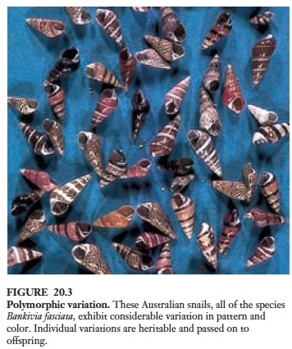
Natural Selection acts on Variations in nature
Natural populations can contain a great deal of genetic variation
Enzyme polymorphisms
DNA sequence polymorphisms
Researchers refer to a locus with more variation than can be explained by mutation as polymorphic

Slide 7
Natural selection can cause allele frequencies to change
Population genetics is the study of the properties of genes in populations.
Selection, scientists then thought, should always favor an optimal form, and so tend to eliminate variation.
The theory of blending inheritance—in which offspring were expected to be phenotypically intermediate relative to their parents—was widely accepted.
This is something that Darwin had trouble explaining!

Slide 8
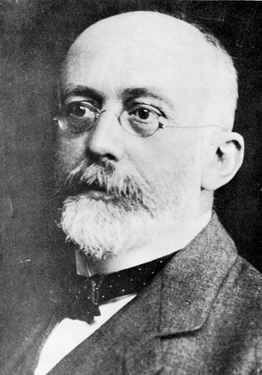
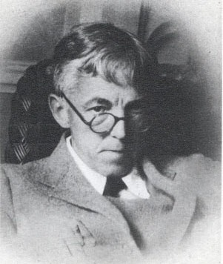
Hardy and Weinberg
Following the rediscovery of Mendel’s research two people in 1908 independently solved the puzzle of why genetic variation persists.
G.H. Hardy – English mathematician
W. Weinberg – a German physician

Slide 9
Hardy and Weinberg
Both pointed out that the original proportions of the genotypes in a population will remain constant from generation to generation as long as the following assumptions are met
The population size is very large
Random mating is occurring
No mutation takes place
No genes are input from other sources (immigration or emigration)
No selection occurs

Slide 10
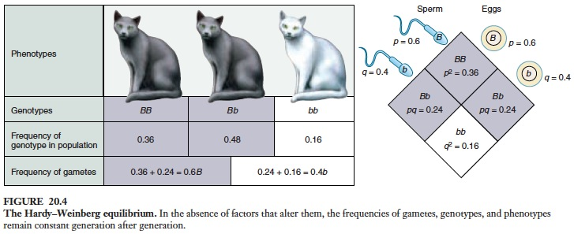
Hardy-Weinberg in algebraic terms

Slide 11
An example
Cycstic fibrosis is a serious human disease that causes thick, sticky mucus to build up in the lungs and digestive tract. This allele is present in North Americans of Caucasian descent at a frequency “q” of about 22 per 1000 individuals. What proportion of North American Caucasians, therefore, is expected to express this trait?

Slide 12
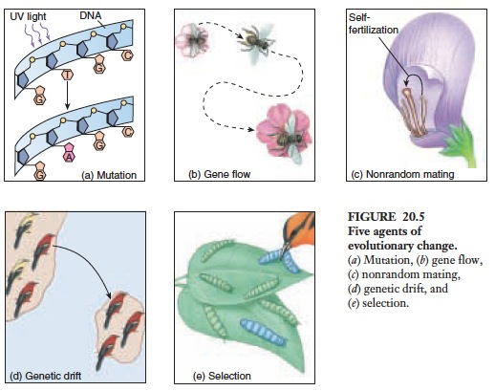
Why do allele frequencies change?
According to the Hardy–Weinberg principle, both the allele and genotype frequencies in a large, random-mating population will remain constant from generation to generation if no mutation, no gene flow, and no selection occur.

Slide 13
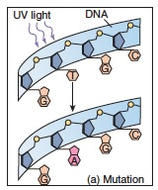
Mutation
Mutation from one allele to another can change the proportions of particular alleles in a population.
Very infrequent- a single gene can mutate about 1 to 10 times per 100,000 cell divisions
Even though its slow it’s the ultimate source of genetic variation
Can transfer advantage, disadvantage
or could be neutral

Slide 14
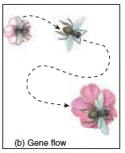
Gene Flow
Gene flow is the movement of alleles from one population to another (i.e. when two populations exchange genes)
Sometimes gene flow is obvious, as when an animal moves from one place to another.
Other are not i.e. drifting of gametes or immature stages of plants or animals from one place to another.

Slide 15
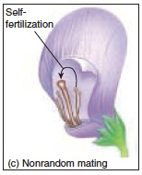
Nonrandom mating
Individuals with certain genotypes sometimes mate with one another more commonly than would be expected (i.e. sexual selection)
Interbreeding
In plants outcrossing (i.e. cross-pollination) vs self-pollination

Slide 16
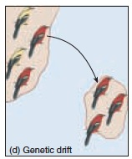
Genetic Drift
In small populations, frequencies of particular alleles may change drastically by chance alone called genetic drift (this is why a population must be large to be in HWE)
Two related causes of decreases in a population’s size are:
founder effects
bottlenecks

Slide 17
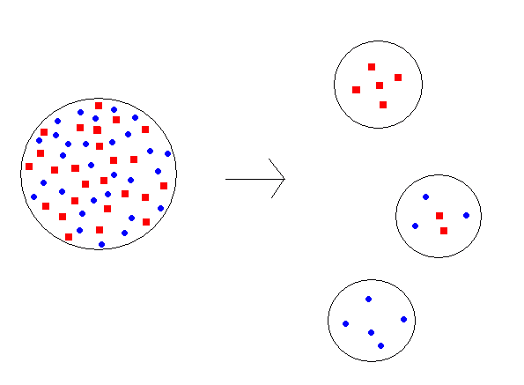
Founder effect
The loss of genetic variation that occurs when a new population is established by a very small number of individuals from a larger population
Iceland population

Slide 18
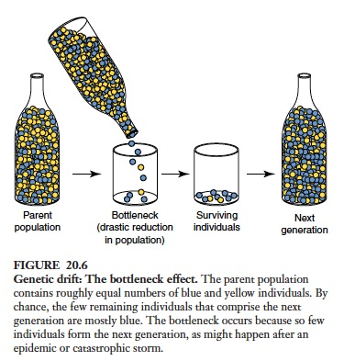
The Bottleneck Effect
Some natural disaster, epidemic or other natural force greatly reduces a populations numbers

Slide 19
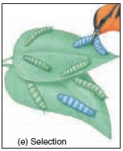
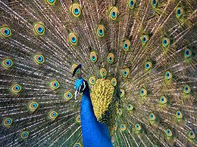
Selection
Darwin pointed out that some individuals leave behind more progeny than others and the rate is affected by phenotype and behavior. The results of this process is selection.
Artificial selection
Natural selection
Sexual selection

Slide 20
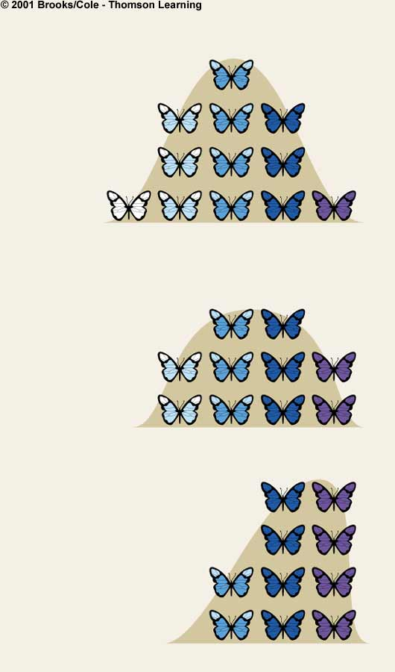
Directional Selection
Number of individuals
in the population
Allele frequencies shift in one direction
Range of values for the trait at time 1
Number of individuals
in the population
Range of values for the trait at time 2
Number of individuals
in the population
Range of values for the trait at time 3

Slide 21
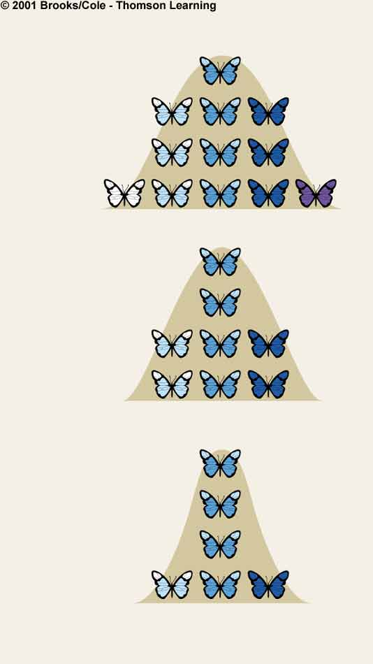
Stabilizing Selection
Number of individuals
in the population
Intermediate forms are favored and extremes are eliminated
Range of values for the trait at time 1
Range of values for the trait at time 2
Range of values for the trait at time 3

Slide 22
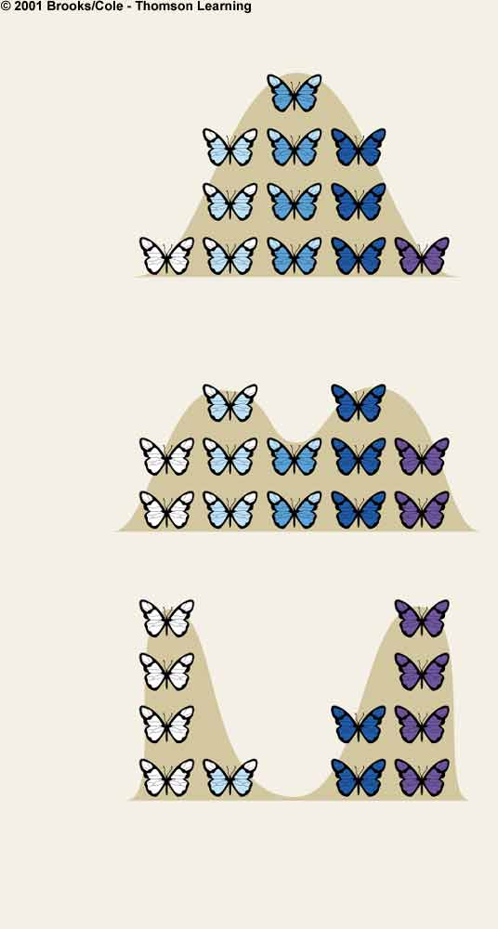
Disruptive Selection
Number of individuals
in the population
Forms at both ends of the range of variation are favored
Intermediate forms are selected against
Range of values for the trait at time 1
Number of individuals
in the population
Range of values for the trait at time 2
Number of individuals
in the population
Range of values for the trait at time 3

Slide 23
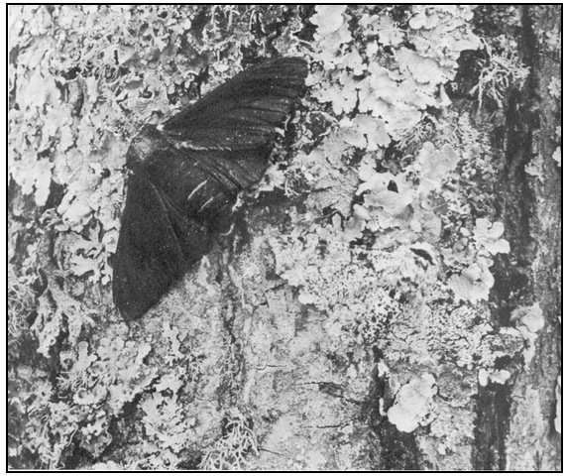
Peppered Moths

Slide 24
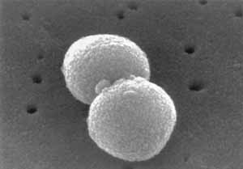
Antibiotic Resistance
Forty or fifty years ago, thanks to anitbiotics, scientists thought medicine had all but eradicated infectious agents as a major health threat. Instead, the past two decades have seen an alarming resurgence of infectious diseases and the appearance of new ones.
Formation of whats termed “super bugs”
Is this artificial selection?

Slide 25
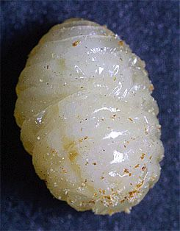
Selection for Gall Size
Gall-making fly has two major predators
Wasps prey on larvae in small galls
Birds eat larvae in large galls

Slide 26
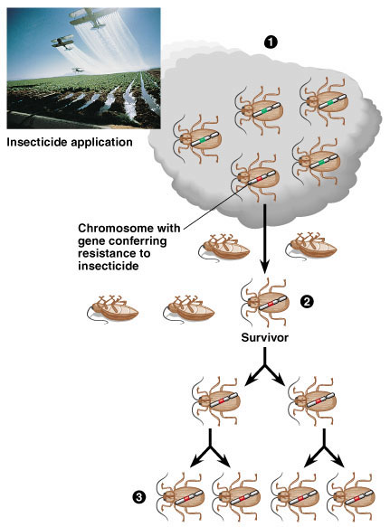
Pesticide Resistance

Slide 27
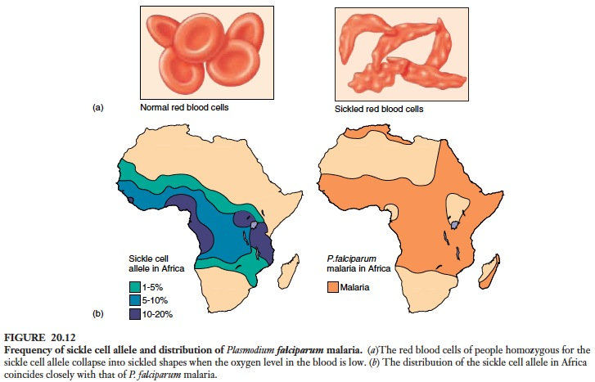
Heterozygous advantage

Slide 28
Macroevolution and Speciation

Slide 29
Macroevolution
Macroevolutionary studies focus on change that occurs at or above the level of species, in contrast with microevolution, which refers to smaller evolutionary changes (typically described as changes in allele frequencies) within a species or population
There are four types of evolutionary patterns.

Slide 30
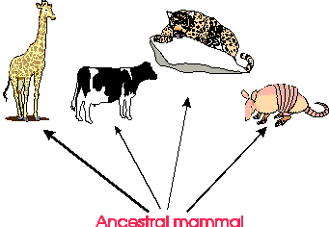
Divergent Evolution
Describes two or more species that evolved from a common ancestor.
Adaptive radiation involves numerous divergences from a common ancestor into a number of descendants that have exploited different niches in the environment.

Slide 31
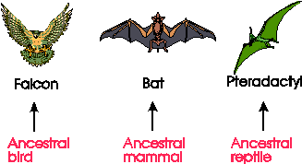
Convergent Evolution
Convergent evolution describes two or more unrelated species that have adopted similar adaptations to their environment.

Slide 32
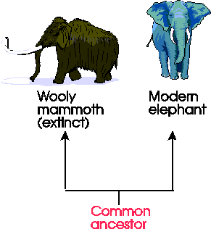
Parallel Evolution
Parallel evolution describes two or more species that have continued to evolve similar characteristics even after their divergence from a common ancestor.

Slide 33
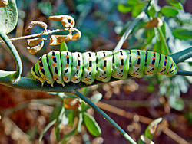
Co-evolution
Coevolution describes the evolution of one species in response to the evolution of another. Coevolution usually occurs in a predator-prey relationship.
Old world swallowtail caterpillar on fringed rue

Slide 34
Species Definition
A species is usually defined as a group of individuals capable of interbreeding
To make new specie you need to disrupt gene flow
Speciation is the formation of new species and can occur in a number of ways
Allopatric speciation
Parasympatric speciation
Sympatric speciation

Slide 35
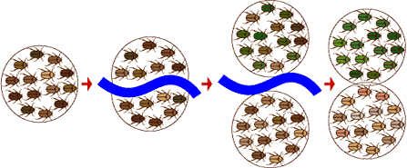
Allopatric Speciation
Allopatric Speciation- production of species as result of geographic barriers.

Slide 36
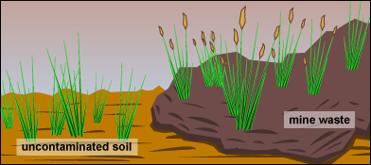
Parapatric Speciation
Parapatric speciation is when there is no specific extrinsic barrier to gene flow. The population is continuous but the population does not mate randomly.

Slide 37
Sympatric Speciation
Sympatric speciation is the formation of new species without the presence of a geographic barrier.
Balanced polymorphism- biology occurs when two or more clearly different phenotypes exist in the same population of a species – in other words, the occurrence of more than one form or morph
Polyploidy- possession of more than the normal two sets of chromosomes found in diploid cells
Hybridization- occurs when two distincly different forms of a species (or closely related species that are normally reproductively isolated) mate and produce progeny along a geographic boundary called a hybrid zone.

Slide 38
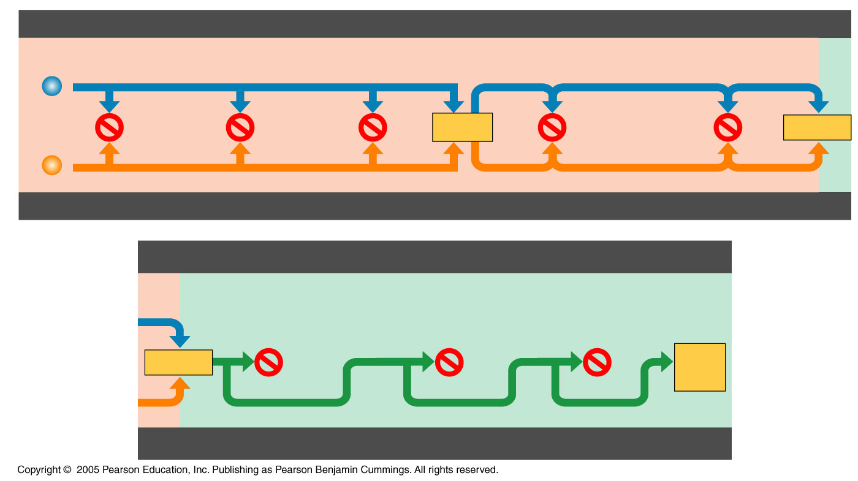
Reproductive Isolating Mechanisms
Prezygotic barriers impede mating or hinder fertilization if mating does occur
Habitat
isolation
Temporal
isolation
Behavioral
isolation
Mechanical
isolation
Gametic
isolation
Individuals
of
different
species
Mating
attempt
Fertilization
HABITAT ISOLATION
TEMPORAL ISOLATION
BEHAVIORAL ISOLATION
MECHANICAL ISOLATION
GAMETIC ISOLATION
Postzygotic barriers prevent a hybrid zygote from
developing into a viable, fertile adult
Reduced
hybrid
viability
Reduced
hybrid
fertility
Hybrid
breakdown
Fertilization
Viable,
fertile
offspring
REDUCED HYBRID
VIABILITY
REDUCED HYBRID
FERTILITY
HYBRID BREAKDOWN

Slide 39
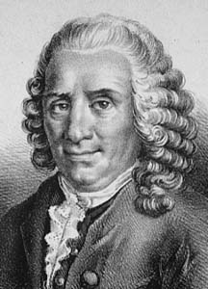
Linnaeus
Carolus Linnaeus (1707–1778), a Swedish physician and botanist
Sought to classify life’s diversity “for the greater glory of God.”
binomial: two-part Latin name of a species
Considered the father of taxonomy

Slide 40
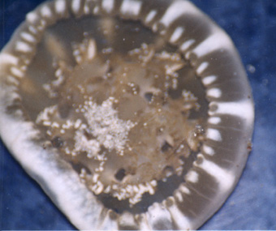
Example
Cassiopea xamachana
Cassiopea-genus
Xamachana-species

Slide 41
Taxonomy
Linnaeus was a founder of taxonomy,
Branch concerned with naming and classifying organisms.
He developed the two–part, or binomial, system of naming organisms according to genus and species.
Nested classification system, grouping similar species into increasingly general categories.
To Linnaeus, the observation that some species resemble each other did not imply evolutionary kinship, but rather the pattern of their creation.

Slide 42
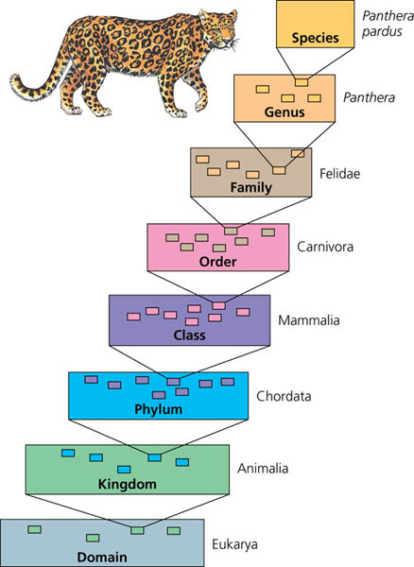
Modern Taxonomic System

Slide 43
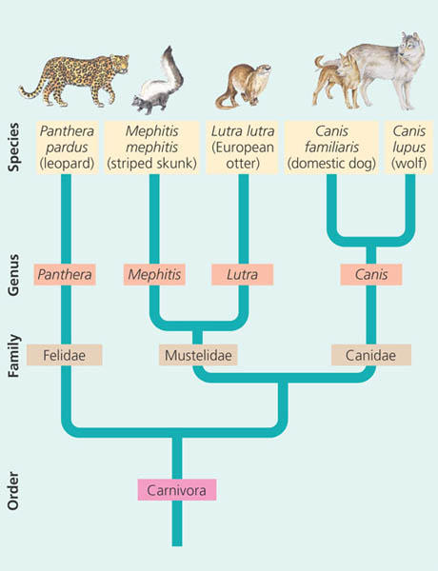
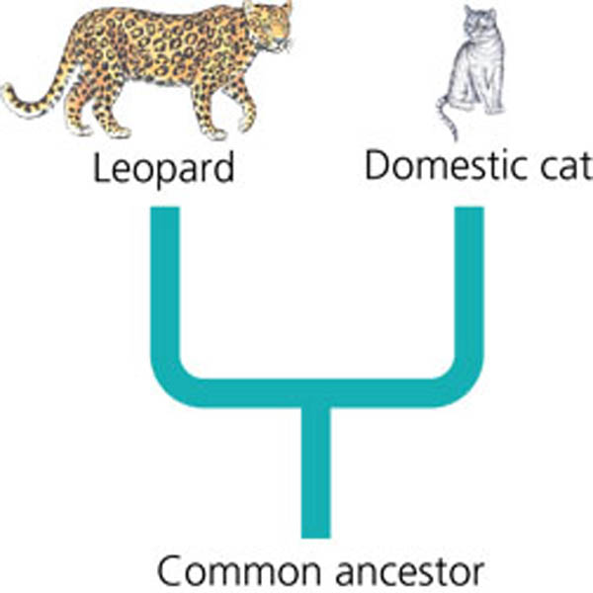
Linking Classification and Phylogeny
Systematists use branching diagrams called phylogenetic trees to depict their hypotheses about evolutionary relationships.

Slide 44
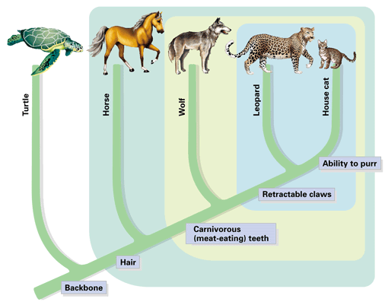
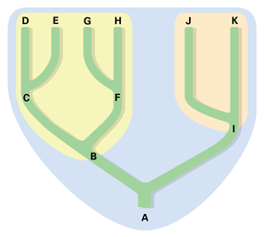
Clades and Cladograms Dear God no more!
Cladogram - A diagram depicting patterns of shared characteristics among species.

Slide 45
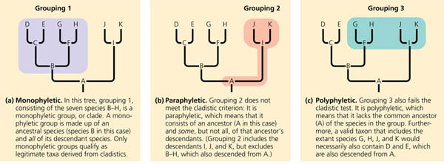
Valid Clades
Monophyletic- Pertaining to a grouping of species consisting of an ancestral species and all its descendants; a clade
Paraphyletic- Pertaining to a grouping of species that consists of an ancestral species and some, but not all, of its descendants.
Polyphyletic- Pertaining to a grouping of species derived from two or more different ancestral forms.

Slide 46
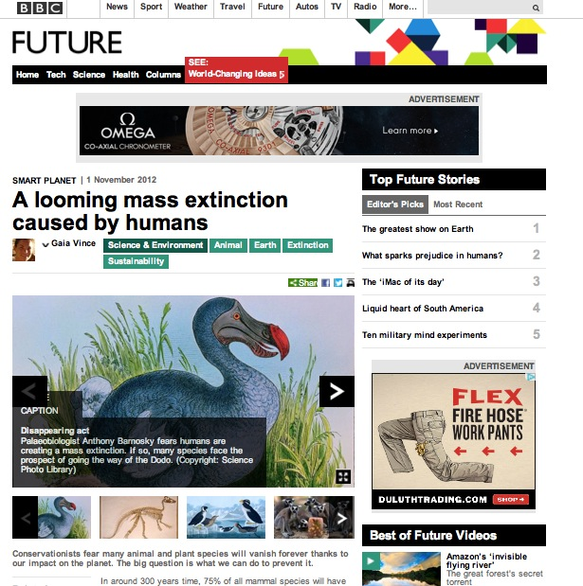
Extinction

