Slide 1
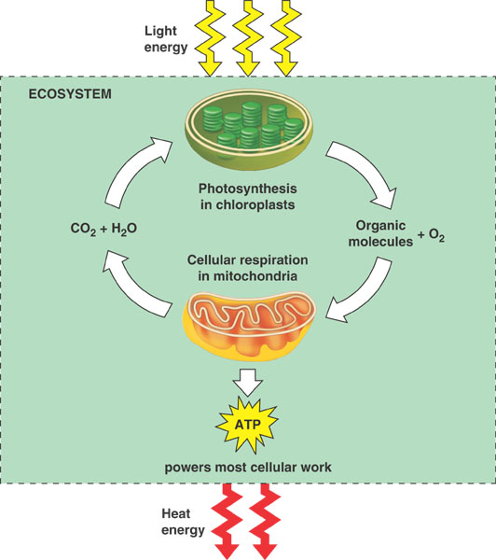
Figure 9.1 Energy flow and chemical recycling in ecosystems

Slide 2
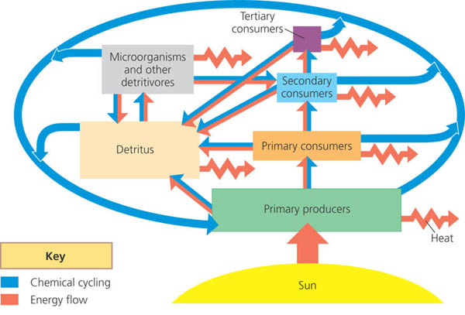

Slide 3
How are these images related to each other?

Slide 4
Productivity
-What is productivity?
-How can productivity be measured?
-Can we differentiate between the productivity of the producers vs. consumers?

Slide 5
Gross Primary Productivity
gross primary production (GPP)- The total energy assimilated by producers.
net primary production (NPP)- The gross primary production of an ecosystem minus the energy used by the producers for respiration (energy per unit area per unit time (J/m2/yr) biomass (weight) of vegetation added to the ecosystem per unit area per unit time (g/m2/yr).
NPP = GPP - R

Slide 6
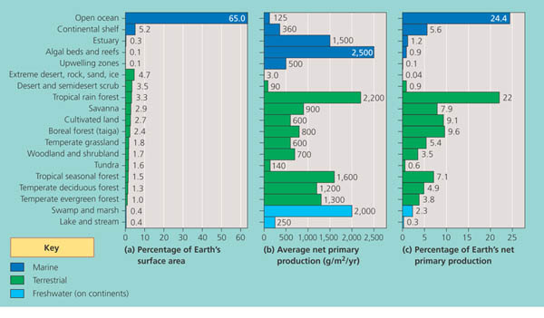
NPP for Different Biomes

Slide 7
Regional annual NPP for Earth.

Slide 8
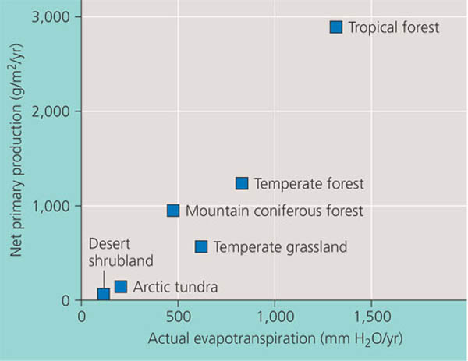
Another way to measure

Slide 9
Limiting factors
What are some limiting factors for marine biomes? Freshwater biomes? Terrestrial biomes?

Slide 10
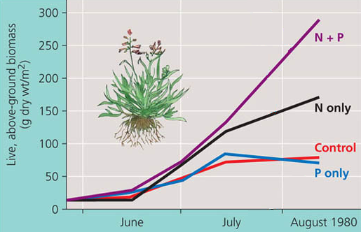
What is the limiting nutrient?

Slide 11
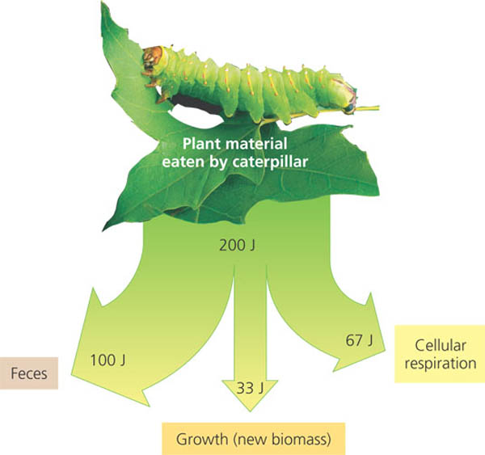
Secondary Productivity
Secondary productivity- amount of chemical energy in consumers’ food that is converted to their own new biomass during a given time period

Slide 12
Trophic Efficiency
Trophic efficiency is the percentage of production transferred from one trophic level to the next.
Trophic efficiencies usually range from 5% to 20%, depending on the type of ecosystem.
In general when thinking about these, use the 10% rule.

Slide 13
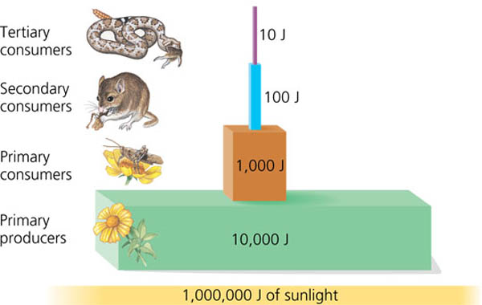
Amount of energy transferred…

Slide 14
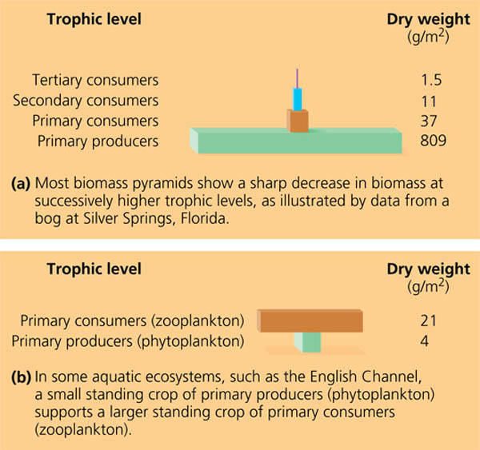
Explain these numbers…
Because the phytoplankton continue to replace their biomass at such a rapid rate, they can support a biomass of zooplankton bigger than their own biomass.
turnover time-The time required to replace the standing crop of a population or group of populations (for example, of phytoplankton), calculated as the ratio of standing crop biomass to production.

Slide 15
Practice AP Question

Slide 16
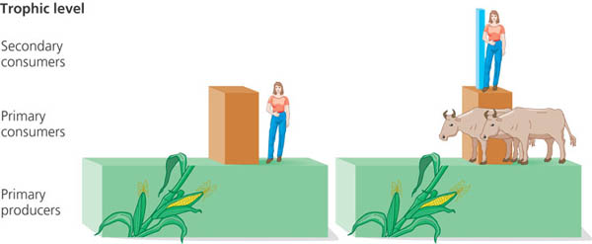
The reality…
In a bluegrass field in Michigan
So what does that mean for humans?

