Slide 1
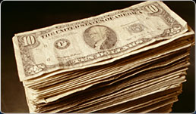
Intro to Fiscal and Monetary Policies Unit IV: Finance and Banking and Unit V: Inflation & Unemployment Stabilization Policies
Mr. Griffin
AP Econ – Macro

Slide 2
The Basics
Fiscal Policy:
government spending
taxing
borrowing
Monetary Policy:
regulating the economy by controlling the amount of money in circulation and the level of interest rates

Slide 3
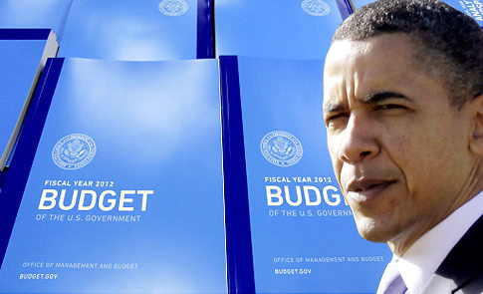
Part I - Fiscal Policy

Slide 4
The Basics of Fiscal Policy
The players
Executive
Congress
Taxes = revenues
Spending = outlays
Issues
Slow
Political

Slide 5
Federal Discretionary and Mandatory Spending
The Federal Budget can be divided into two types of spending according to how Congress appropriates the money:
discretionary
refers to the portion of the budget which goes through the annual appropriations process each year
mandatory
Required by statute – Social Security, etc.

Slide 6
Annual Budget Process
Step 1: President Submits a Budget Proposal;
Step 2: Congress Passes a Budget Resolution
Step 3: Congressional Subcommittees 'Markup' Appropriation Bills;
Step 4: The House and Senate Vote on Appropriation Bills and Reconcile Differences;
Step 5: The President Signs each Appropriation Bill and the Budget is
Enacted.
http://www.nationalpriorities.org/Federal+Budget+Timeline

Slide 7
Fiscal Policies to Encourage Growth
EXPANSIONARY
Increase Spending and Lower Taxes
More money stimulates the economy
Cuts taxes increases disposable income
Businesses expand and create jobs
Result: increased growth and higher employment

Slide 8
EXPANSIONARY FISCAL POLICY
the multiplier at work...
$5 billion initial
increase in spending
AS
Full $20 billion
increase in
aggregate
demand
P₁
Price level
AD₂
AD₁
$490 $510
Real GDP (billions)

Slide 9
Fiscal Policies to Stabilize
CONTRACTIONARY
Increase Taxes and Lower Spending
Increase taxes to slow the economy and reduce inflation
Less disposable income
Slower business activity leads to lower profits
Result: low inflation rates and stable growth

Slide 10
CONTRACTIONARY FISCAL POLICY
the multiplier at work...
$5 billion initial
decrease in spending
AS
P₂
Full $20 billion
decrease in
aggregate
demand
Price level
P₁
AD₃
AD₄
$510 $522
Real GDP (billions)

Slide 12
Graphs of Fiscal Policy Trends and Recent Developments

Slide 13
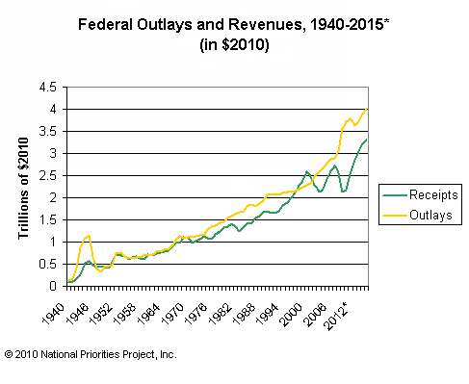
Source: Office of Management and Budget,

Slide 14
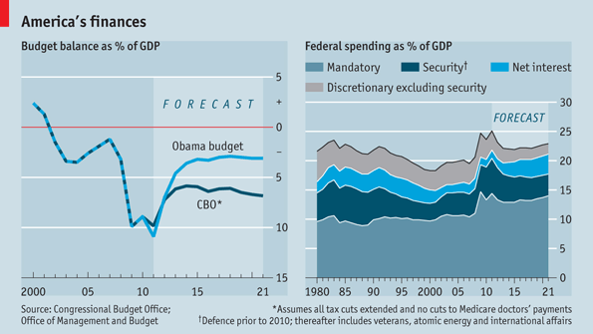
Source: The Economist

Slide 15
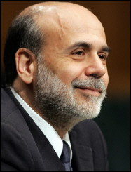
Part II – Monetary Policy

Slide 16
Monetary Policy
Federal Reserve System:
Independent government agency created in 1913
Controls how much money is in circulation
12 Regional Federal Reserve Banks and 13,000 Private Member Banks
Fed Chairman oversees Board of Governors that supervise the Fed’s Banking services and policies
Monetary Policy is Fast
instantaneous impact on markets and banking / financial system
Not burdened by the political process or government bureaucracy of fiscal policy

Slide 17
THE FEDERAL RESERVE AND
THE BANKING SYSTEM
Federal
Open Market
Committee
Board of
Governors
12 Federal
Reserve Banks
Commercial
Banks
Thrift Institutions
(Savings & loan associations,
mutual savings banks, credit
unions)
The Public
(Households and
businesses)

Slide 19
Monetary Policy Tools
Reserve Requirements:
Determines the minimum $ that banks must have at all times
Discount rate:
interest rate the fed charges to member banks
Lower rate more likely to borrow from FED = more money in the economy = more loans
Higher rate = less money in the economy loans more difficult to obtain
Open-market operations:
Purchase or sale of bonds on the open market
Bonds: certificates issued by the government to a lender from whom it has borrowed money
Increases money in the economy by buying bonds; decreases money by selling bonds

Slide 21
MONETARY POLICY AND EQUILIBRIUM GDP
S_{m1}
S_{m2}
S_{m3}
Investment
Demand
10
8
6
0
10
8
6
0
Real rate of interest, i
D_{m}
Quantity of money demanded and supplied
Amount of investment, i
AS
If the Money Supply
Increases to Stimulate
the Economy…
Interest Rate Decreases
P₃
Price level
Investment Increases
P₂
AD & GDP Increases
with slight inflation
P₁
AD₃(I=$25)
AD₂(I=$20)
Increasing money supply
continues the growth –
but, watch Price Level.
AD₁(I=$15)
Real domestic output, GDP

Slide 22
The Rates
Fed Funds:
Bank to bank overnight loans
Discount:
Fed to banks
Prime:
Banks to you (if you have good credit)
Fed funds + 3%

Slide 23
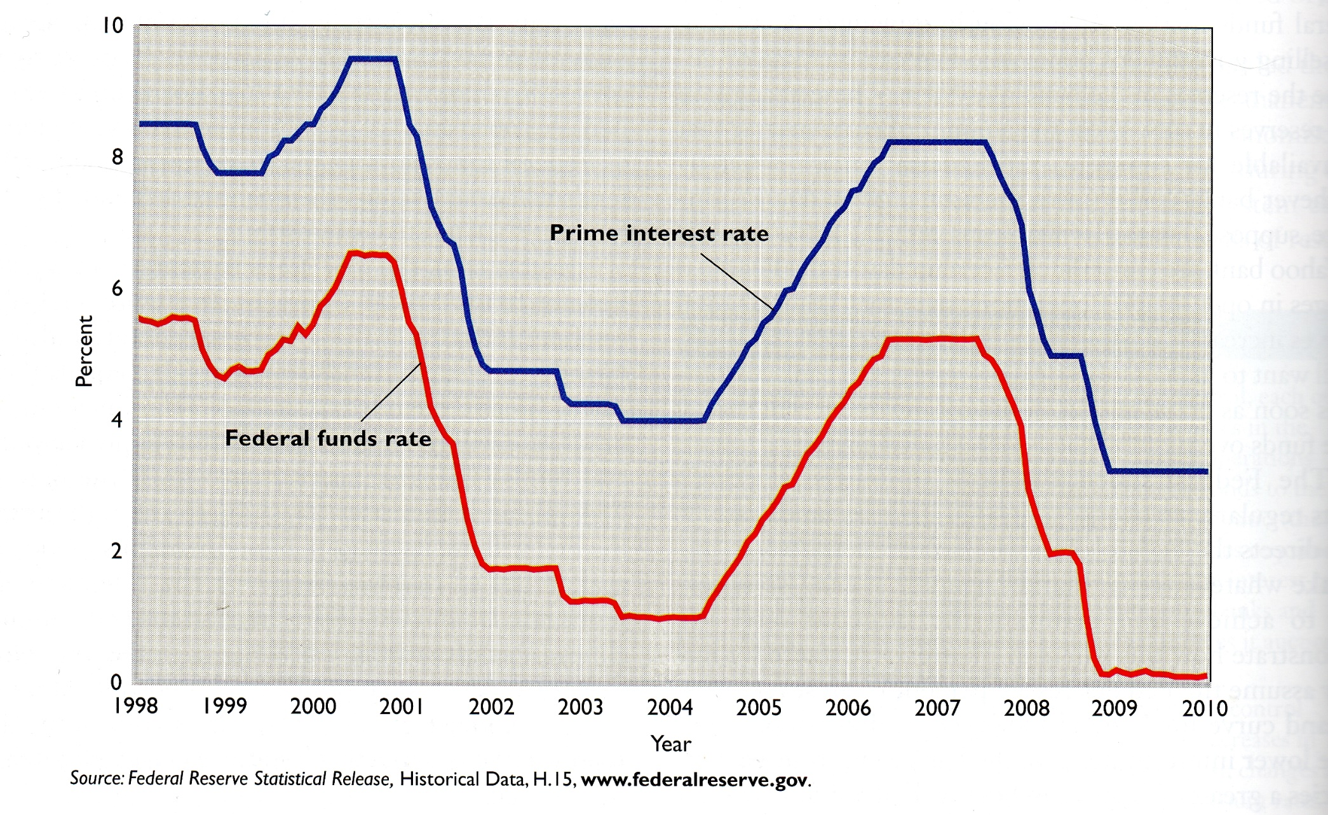

Slide 24
Impact on Xn

